Slide 1

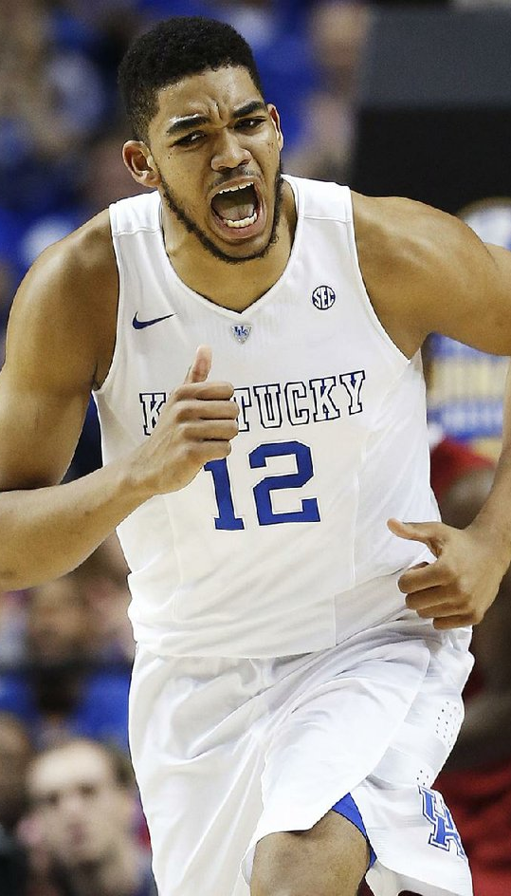

Predicting NBA Success
John Ajit, Nate Dorsey, Ben Kim

Slide 2
Description of what we did

Slide 3
Formula

Slide 4
Explain what and why

Slide 5
Show plot of all college student with average line

Slide 6
Plot showing all star, bust, and regular

Slide 7
Explain how we got the numbers for the y lines

Slide 8
Show example of player (expected and actual)

Slide 9
Conclusion

